Slide 1
Short-Range Radar
for remote detection of objects through
optically opaque barriers
Vladimir Kropotov
Technology author. President and Founder of RADIO VISION.
The seventh Scientific and Practical Conference
«Territorially-distributed security systems»
Kaliningrad 2015

Slide 2
About Us
Radio Vision was established in 2012 by the team of highly experienced professionals.
We develop high-tech microelectronic products and software. The significant breadth of expertise within our company enables us to be involved in the full life cycle of our products from the initial concept to mass production.

Slide 3
Radio Vision and Skolkovo
Since 2012 Radio Vision is a member of Skolkovo Nuclear Cluster
(Certificate #1120313)

Slide 4
Our Technology
We developed an area scanning technology, which employs narrowly focused beams of electromagnetic waves and scans a target area in horizontal and vertical planes providing 3D visualization of results.
This is a breakthrough technology that has
no analogs in the world.
We already created RK-000 Narrow-Band Microwave Radar prototype that is fully based on this technology.

Slide 5
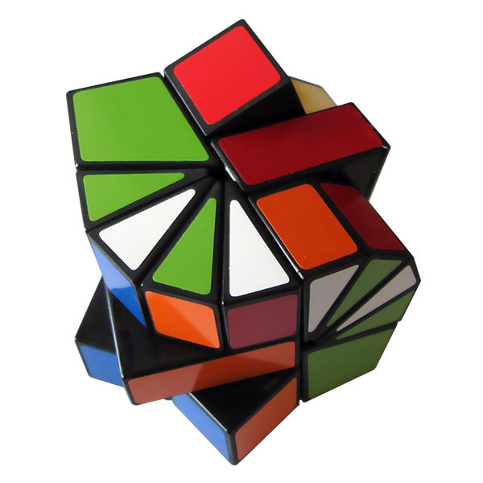
Our Technology
Our technology is a complex of:
Innovative methods and program algorithms;
Technical brainstorming;
Brand new hardware components;
Production methods and setting techniques.
Why innovative?
Narrowband radiation and narrowly focused beams of electromagnetic waves;
Continuous radiation;
No Doppler effect employed.

Slide 6
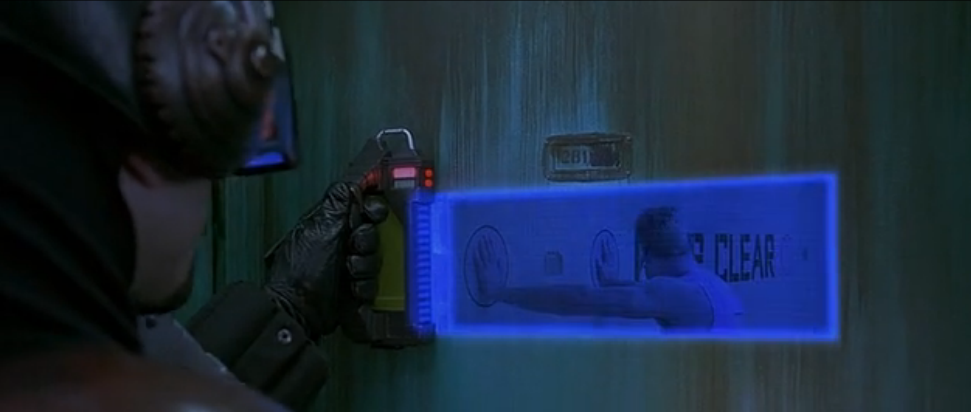
Problem
A radar that allows to detect, accurately locate and identify terrorists behind an opaque wall:
* a frame from The Fifth Element movie

Slide 7
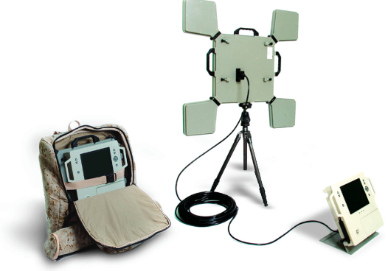
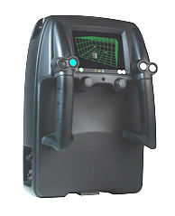
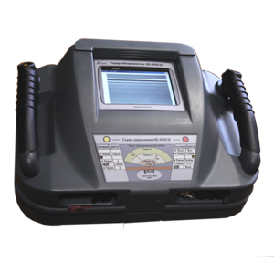
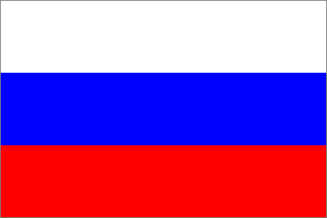
Existing Solutions
Radars that use ultra-wide band (UWB) technology
to detect objects through barriers:
Xaver 800
Prism 200
РО-400

Slide 8
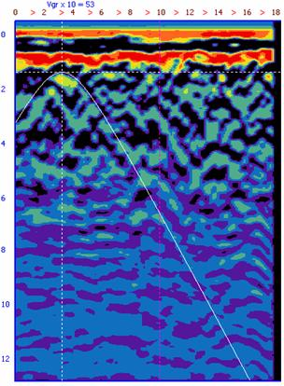
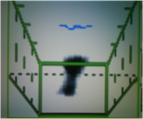
Visualization of Radar Data
UWB radars
RK-000 narrow-band radar
Radarscope data correct interpretation fully depends on operator’s skills and knowledge.
Objects are displayed as realistic pseudo-3D images (with lower quality if compared with videocamera shoots). Does not require interpretation by an operator!

Slide 9
Key Advantages of our Radars
Short data acquisition time;
Accurately measure and locate an object hidden by an opaque barrier;
Highly reliable real-time displaying of an object;
Smooth operation even when the noise level exceeds tens or even hundreds times the level of reflected signal;
Cannot be affected by existing jammers and signal suppressors;
Less observable, or even invisible, to different detection methods;
Radiation power is lower than 10 mW.

Slide 10
Key Advantages of our Technology
Parameters | Ultra-wide band radars | Radio Vision Radars (narrow-band microwave radar)
Target acquisition time | up to 30 seconds | 0,05 second, in real-time 50 fps
Accuracy in target coordinates measurements | Low due to wide-beam antennas | High due to narrow-beam anntennas
Target discrimination (ability to determine target size and surface area) | No, due to focused direction of measurements in a target area. | Yes. Measures 2000 «points» (50 in each of 40 lines within a target area)
Radiating power | More than 10W | 0.01W
Jam-resistance and electromagnetic compatibility | Low due to wide bandwidth of 1000-7000 MHz | High thanks to narrow and tunable bandwidth (approx. 1MHz)
Scan through exceedingly damp barriers | Radar pulses cannot penetrate damp barriers and walls | Exceedingly damp barriers do not influence radar operation and scan quality

Slide 11
Radar Prototypes
Radio Vision
Narrow-Band Microwave Radar
RK - 100
Mini RK - 010

Slide 12
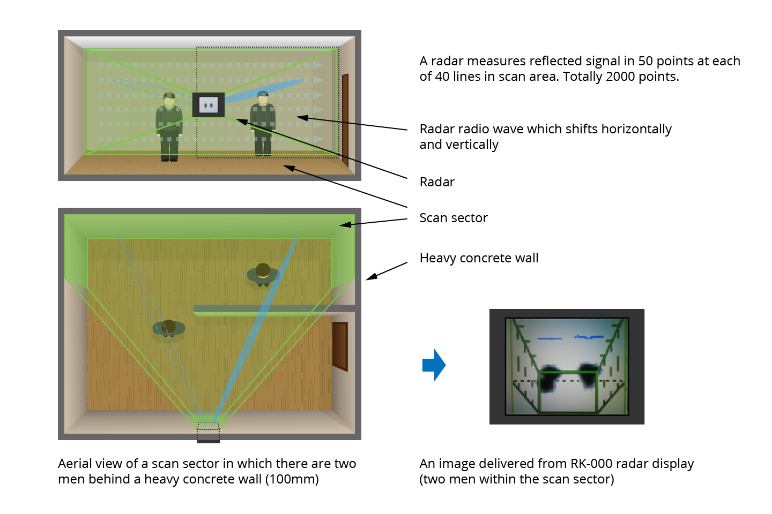
What Do We Offer

Slide 13
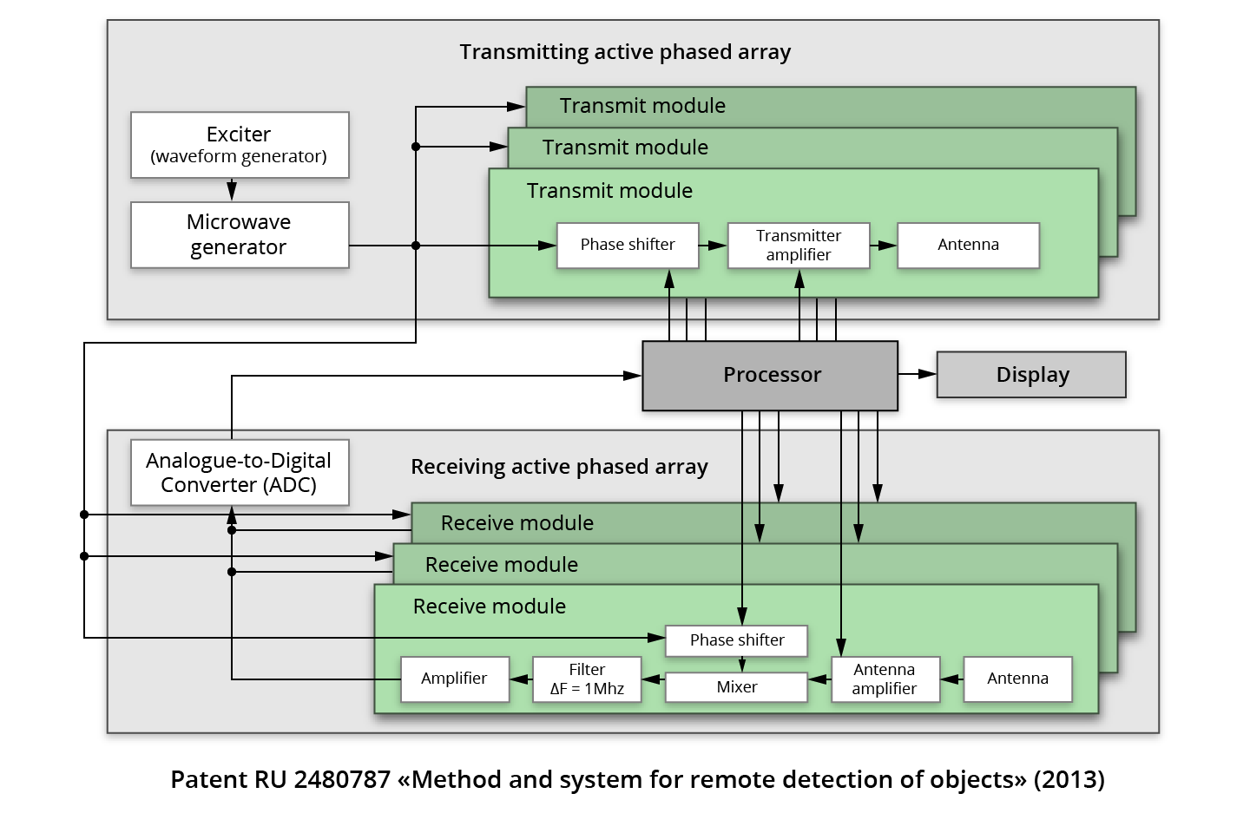
Schematic Structure of RK-000 Radar

Slide 14
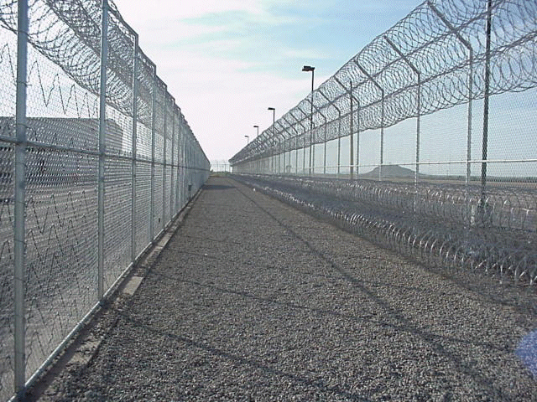
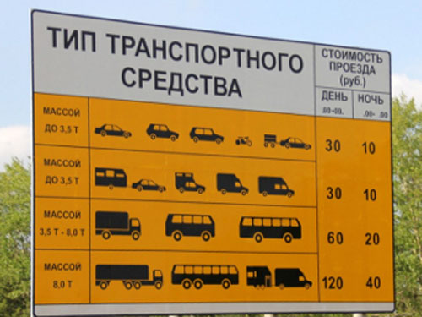
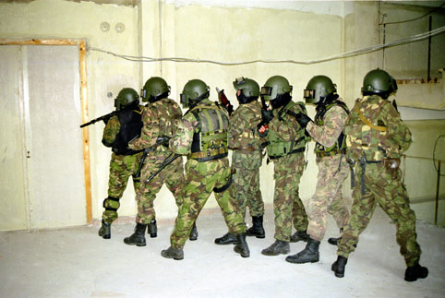
Our Technology
Application of Radio Vision technology:
Perimeter security (airports, prisons, plants, oil&gas facilities);
Open-space protection (fields, hunting areas, access to sensitive sites, sporting facilities);
Vehicle traffic monitoring (for car tracking and monitoring systems and intelligent transport systems). Calculation, classification and detection of vehicles’ velocity.
Special forces of the Ministry of Defense, the Federal Security Service of the Russian Federation, Main Intelligence Directorate (to detect terrorists hidden behind various barriers and victims trapped under rubble).

Slide 15
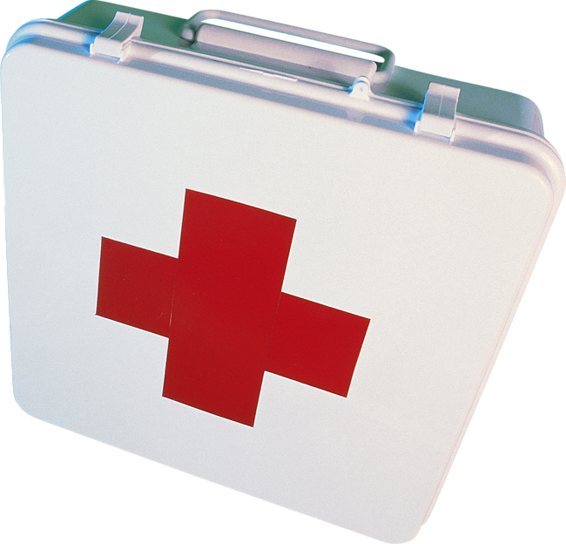
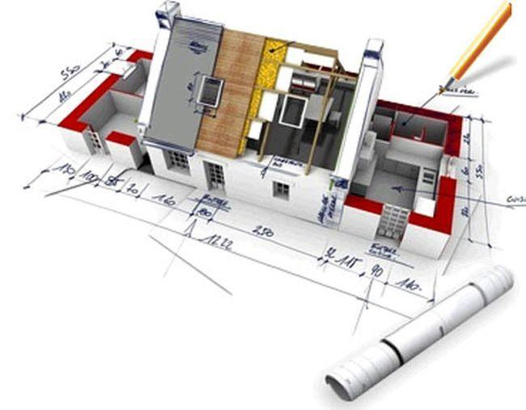
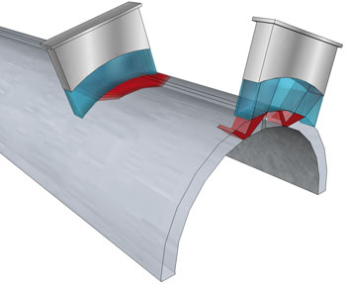
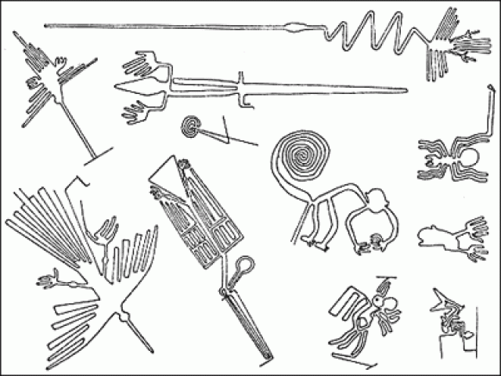
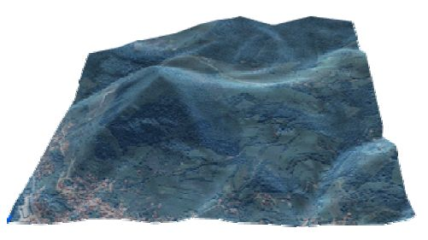
Our Technology
Our technology will allow to create brand new radar apparatus
with 3D imaging for:
Medicine
Construction
Non-destructive testing
Geolocation
Archaeology
We mentioned just a few applications of Radio Vision technology…

Slide 16
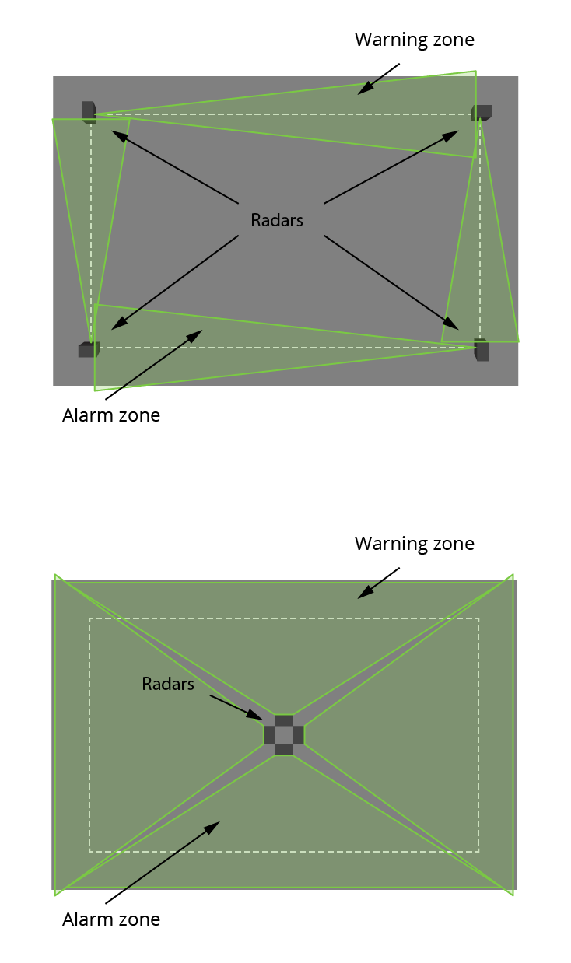
Brand New 3D Devices
for Perimeter and Area Security
PSM-SK Perimeter Security Microwave Scanner
PSM-SK series scanners are intended for perimeter and area security. The devices can be located close to the walls and other barriers without affecting detection quality.
ASM-SK Area Security Microwave Scanner
ASM-SK series microwave scanners are intended for professional 24/7 all-weather site security using radar surveillance.

Slide 17
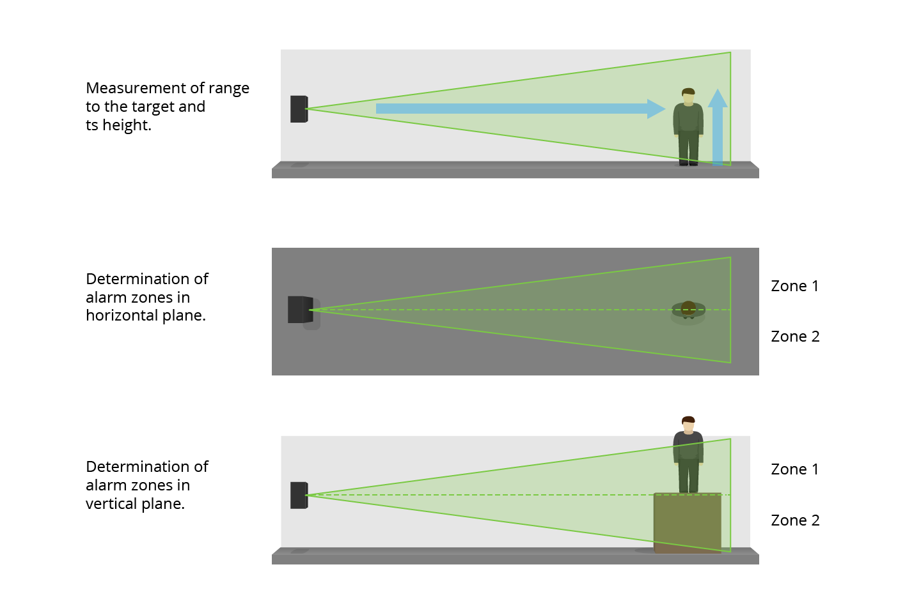
PSM-SK
Perimeter Security Microwave Scanner
The scanner is a new-generation device.
It is completely different from other existing devices.
Employs RadioVision narrowband scanning technology.
Significantly reduces the number of false alarms and provides improved functional and performance characteristics.

Slide 18
PSM-SK
Perimeter Security Microwave Scanner
Specifications | Parameters
Maximum acquisition range | 100…150 meters
The number of measurement directions | 4
Scanning sector, programmable by an operator | from 2 ° to 10 ° (horizontally and vertically)
Resolution | Not less than 1m
Operating temperature | from –40° to + 85° C
«Ready-to-work» preparation time | Not exceeds 5 seconds
Dimensions and weight | 200 x 200 x 50 mm, 1 kg
The scanner examines a controlled area and alarms in case of intrusion. Scan data is transmitted to security system for immediate decision-making. (i/o, RS-485).
The scanner operates regardless of time of day and weather conditions.
Jam-resistant. Cannot be blocked by existing jammers and signal suppressors.

Slide 19
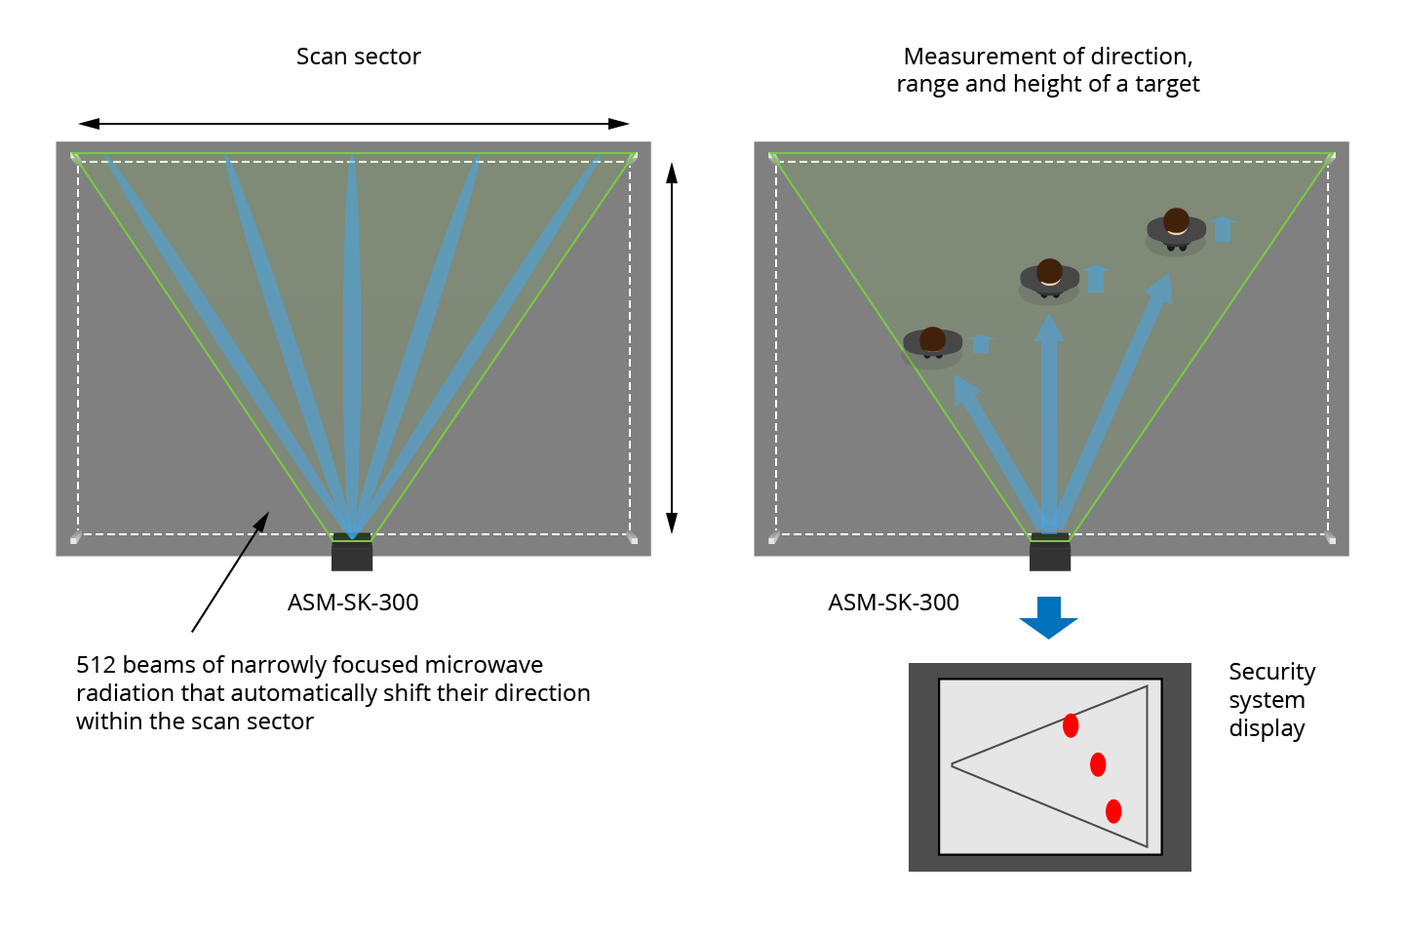
ASM-SK-300
Area Security Microwave Scanner

Slide 20
ASM-SK-300
Area Security Microwave Scanner
Specifications | Parameters
Maximum acquisition range Surface area of a controlled territory | 1000…1500 m Up to 10 000 m²
The number of measurement directions | 512
Scanning sector, programmable by an operator | from 50 ° to 100 ° (horizontally) Sector width - from 50 to 250 m
Resolution | Not less than 1m
Operating temperature | from –40° to + 85° C
«Ready-to-work» preparation time | Not exceeds 5 seconds
Dimensions and wieght | 400 x 200 x 50 mm, 3 kg
The scanner examines a controlled area and alarms in case of intrusion. Scan data is transmitted to security system for immediate decision-making. (i/o, RS-485).
The scanner operates regardless of time of day and weather conditions.
Jam-resistant. Cannot be blocked by existing jammers and signal suppressors.

Slide 21
Key advantages of Radio Vision Scanners
Parameters of microwave scanners | Commonly used scanners | PSM-SK and ASM-SK scanners
Distance from scanner to the point of intrusion | Do not determine the range to intrusion point. Whether the distance is 5 or 155 meters. | determine the range from scanner to intrusion point.
Number of possible controlled areas | Maximum 2 controlled zones. | Maximum 64 zones for PSM-SK, 8 in horizontal plane and 8 vertically. 512 zones for ASM-SK.
Objects classification | No (do not distinguish a difference between the size of a cat and a human) | Determine the size of a target
Suppression | Easily detected radio emission. Can be blocked. | Cannot be blocked because the device "responds" solely to its own transmitted signal.

Slide 22
Key advantages of Radio Vision Scanners
Parameters of Microwave Scanners | Commonly Used Scanners | PSM-SK and ASM-SK Scanners
Resistance to sabotage | Vulnerable to interference. Signal simulators can be embedded into the channel between transmitter and receiver. | Signal simulators cannot be embedded transmitter and receiver are combined inside a single housing.
System informativeness | Output data: yes/ no | Comprehensive data on radio signal path; time, attack source localization, range and intruder’s direction of movement.
Mounting Convenience | Multi-module construction is cost-ineffective (transmitting module, reception module, control module, linking cables) | Single housing
Scanner firmware modification and update | Not available | Microprocessor’s firmware can be modified without device dismounting

Slide 23
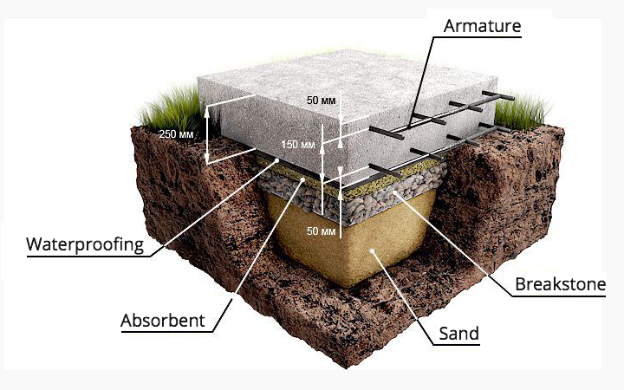
Brand New 3D Apparatus
for Non-destructive Testing, Geologic and Archaeologic Research
Radio Vision technology can also be employed for:
Ground layers examination;
Road engineering & maintenance;
Control over in-situ structural condition;
Detecting dangerous voids and heterogeneity of soil;
Utility locating (detecting conduits, cables and wires, metallic and non-metallic objects, duct banks, vaults and manholes, abandoned lines, concrete pipes, missing valves and much more)
Searching for archaeological objects.
Can be used for various construction and maintenance works.

Slide 24
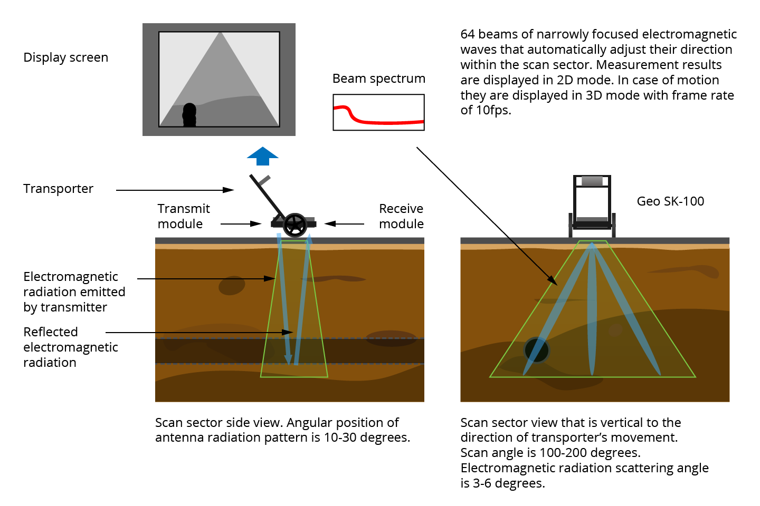
Brand New 3D Apparatus
for Non-destructive Testing, Geologic and Archaeologic Research

Slide 25
Brand New 3D Apparatus
for Radar Breast Tumor Detection
A radio wave in the microwave frequencies can deeply penetrate a human’s body. Such waves are reflected through all the way of propagation within the body.
The major difference between X-rays and microwaves is that the first image only tissue density while microwaves reflect the contrast in dielectric properties between malignant and normal breast tissue.
Normal breast tissues have dielectric constant of approximately 80. Malignant ones - approximately 1, hence wave propagation velocity will be different. The border between invasive cancer cells and the surrounding tissue will additionally enhance signal-to-noise ratio. The contrast between healthy and malignant environments «lays» within the reflected signal, which shall be received, processed and displayed. Using microwaves makes it possible to detect tumors at early stage without using x-ray radiation that has certain limitations.

Slide 26
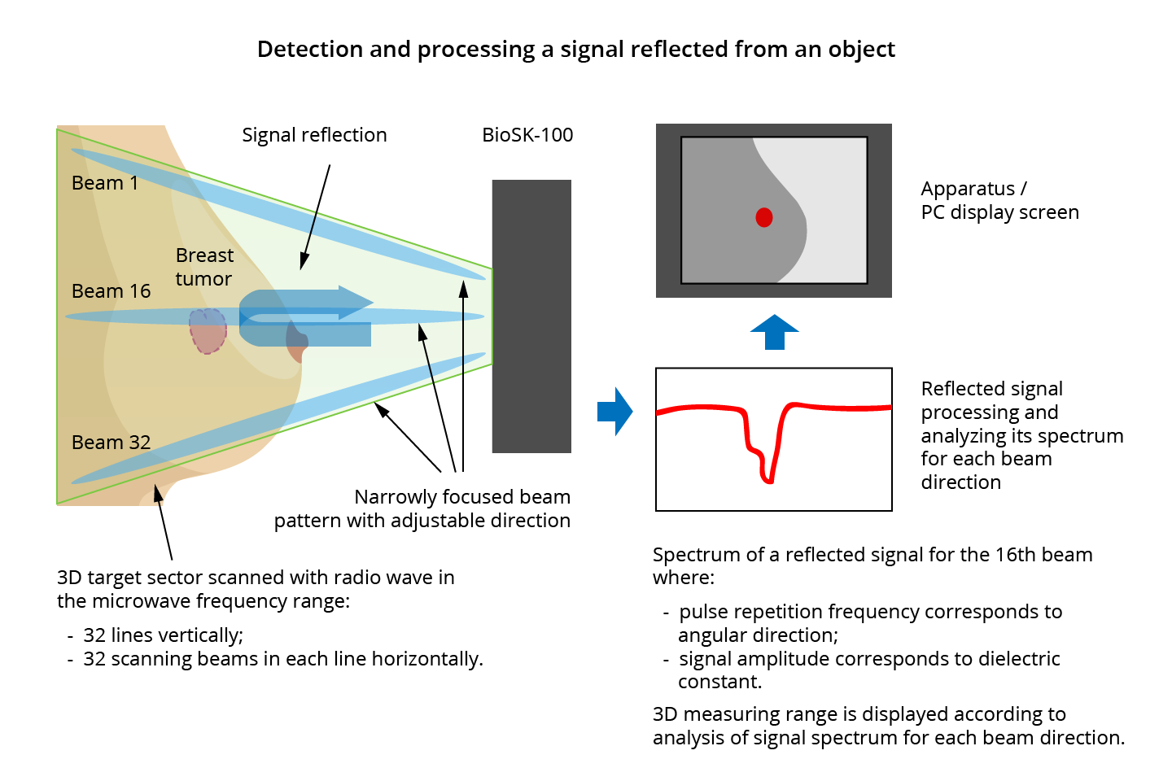
Brand New 3D Apparatus
for Radar Breast Tumor Detection

Slide 27
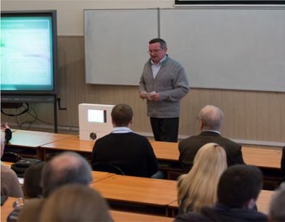
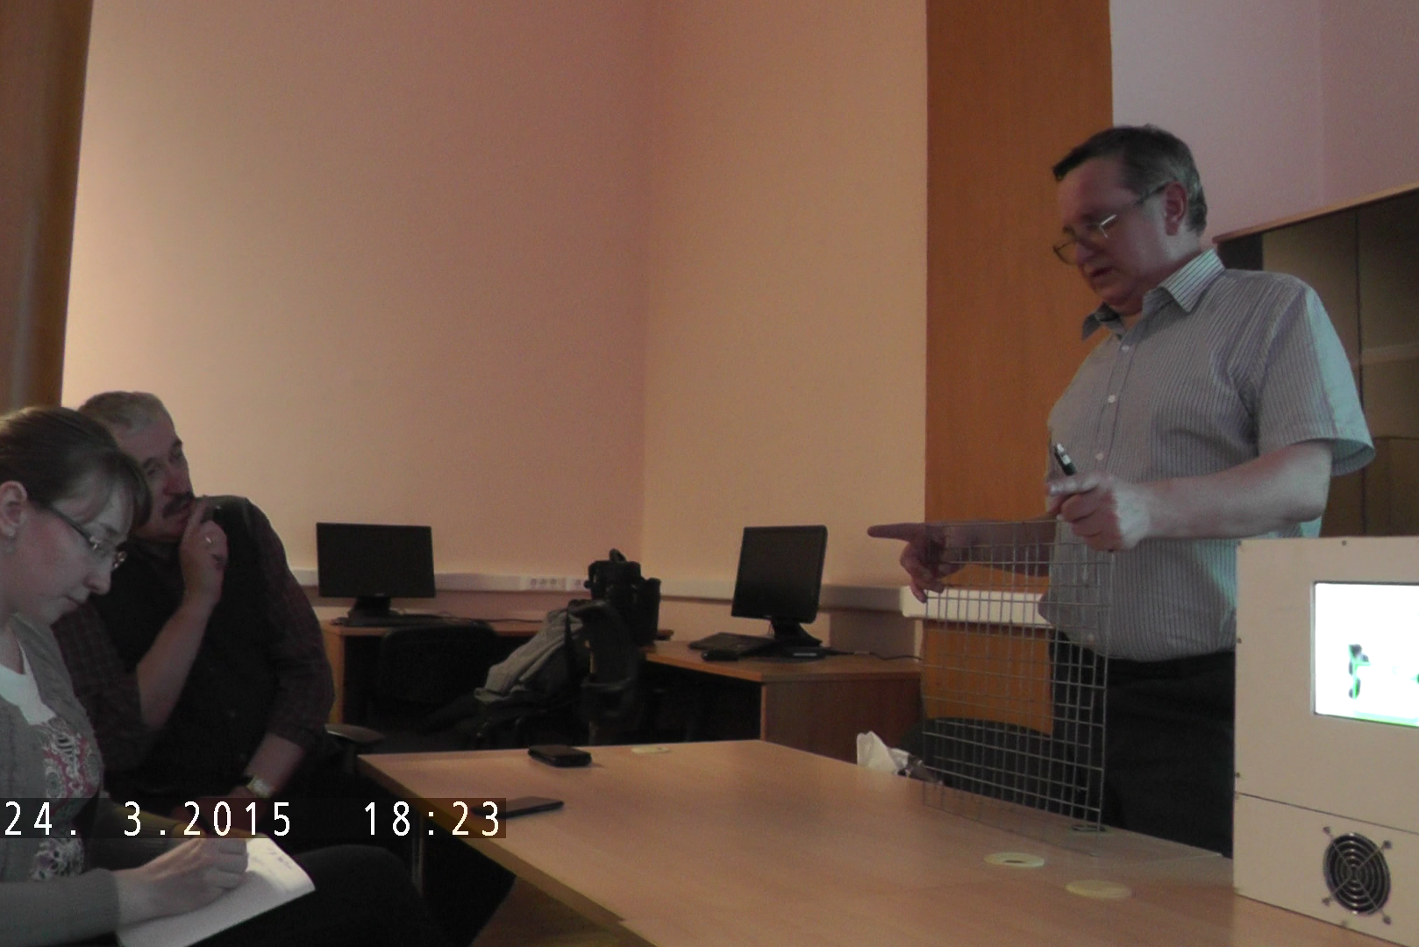
Reports on Radio Vision Project
February 4, 2014
International Scientific Conference «Radar systems of short and ultra-short range» at Bauman University
March 24, 2015
Workshop «Actual problems of contemporary geophysics» at Lomonosov Moscow State University

Slide 28
Thank you!
Radio Vision is open for partnership with experts and potential customers who are interested in our technologies and products that can be applied for different purposes.
Radio Vision offers a range of partner programs to meet the needs of a variety of partner types.
For more information, please visit our website:
www.radio-vision.ru
info@radio-vision.ru

